Slide 3
2 Dundee lads 59.6k views on BBC Scotland Liam Johnston Stuart Hamilton

Slide 4
Doug Dietz Industrial designer with General Electric

Slide 5
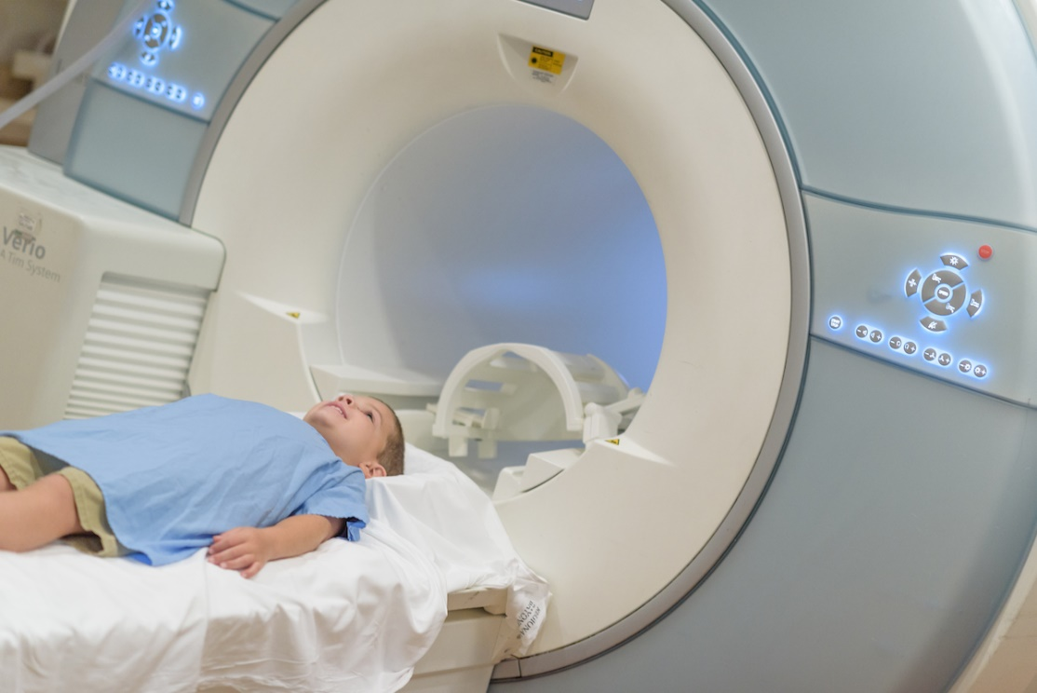
80% of children undergoing MRIs had to be sedated to get through the experience.

Slide 6
“because an excellent spirit, knowledge, and understanding to interpret dreams, explain riddles, and solve problems were found in this Daniel, whom the king named Belteshazzar. Now let Daniel be called, and he will show the interpretation.” (Dan 5:12) “I have heard of you that the spirit of the gods is in you, and that light and understanding and excellent wisdom are found in you.” Dan 5:14) “Then this Daniel became distinguished above all the other high officials and satraps, because an excellent spirit was in him. And the king planned to set him over the whole kingdom.” (Dan 6:3)

Slide 7
Distinguished used to describe a respected and admired person, or their work

Slide 8
1. Determined “””But Daniel Resolved…” 1:8 ESV “Daniel made up his mind…” AMP “Daniel determined…” HCSB “Daniel purposed in his heart…” KJV

Slide 9
Determination is your anchor in the storm and your base in days of battle.

Slide 10
Prayer and Thanksgiving
“He got down on his knees three times a day and prayed and gave thanks before his God as he had done previously.”
Daniel 6:10
“I stop to praise you seven times a day, all because your ways are perfect!”
Psalm 119:164

Slide 11
Don’t worry about anything; instead, pray about everything. Tell God what you need, and thank him for all he has done. Then you will experience God’s peace, which exceeds anything we can understand. His peace will guard your hearts and minds as you live in Christ Jesus. (Php 4:6-7)

Slide 12
Prayer and Thanksgiving
“I am the vine; you are the branches. Whoever abides in me and I in him, he it is that bears much fruit, for apart from me you can do nothing.”
John 15:5

Slide 13
3. 100%
“Whatever you do, work at it with all your heart, as though you were working for the Lord and not for people. Remember that the Lord will give you as a reward what he has kept for his people. For Christ is the real Master you serve.”
(Col 3:23-24)

Slide 14
“Whatever you do, work at it with all your heart…”
“…work heartily…” ESV and NASB
“…work from the soul [that is, put in your very best effort]…” AMP
“…do it enthusiastically…” HCSB
“…Do your best. Work from the heart…” MSG

Slide 15
Granny Elmo
i learned a great principle . “ growing up , if a job is worth doing it’s worth doing it well “ and it became a conviction . I could never do a sloppy job no matter whether i liked the work or not . I was blessed with great teachers and examples of excellence. I took great pleasure in learning from them . A hard work ethic , respect and healthy attitude were values that were of great importance .
I have always enjoyed bringing beauty to a meal , room , atmosphere or a persons life .

Slide 16
Granny Elmo
Your reputation is everything . I helps you massively to get on on in life . Employers love to hire people with these values . It made me feel good about myself and gave me great sense of achievement. Giving 100 % effort to the jobs i didn’t particularly like eg . cleaning toilets in hospital casualty , led me to my dream job in nursing . “ Work willingly at whatever you do, as though you were working for the Lord rather than for people.” Collisions 3 v 23 Deep satisfaction comes from doing a job well . When people complained about their jobs i was always grateful I had one and able to earn . I had a number of jobs which some saw as menial but I never ever felt any job was below me . “ A good name is more desirable than great riches; to be esteemed is better than silver or gold. “ Proverbs 22 : 1

Slide 17
“Whoever is faithful in small matters will be faithful in large ones; whoever is dishonest in small matters will be dishonest in large ones.”
(Luk 16:10)
'Well done, you good and faithful servant!' said his master. 'You have been faithful in managing small amounts, so I will put you in charge of large amounts. Come on in and share my happiness!'
(Mat 25:23)

Slide 19
Doug Dietz Industrial designer with General Electric

