Slide 1


Slide 2
“The voice can only reproduce what the ear can hear.”

Slide 3

Nothing has the potential to change your life like the whisper of God.

Slide 4

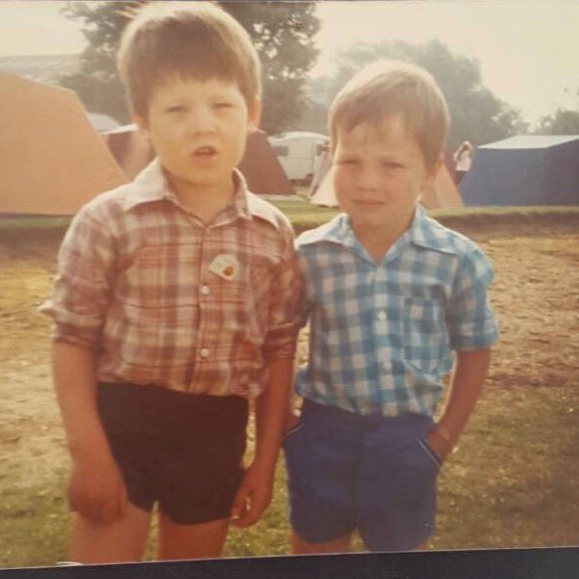
Nothing has the potential to change your life and the life of others like the whisper of God.

Slide 5

And after the fire the sound of a low whisper.

Slide 6

Faith comes by hearing

Slide 7
And she had a sister called Mary, who sat at the Lord's feet and LISTENED…

Slide 8

He speaks in a whisper because Father wants his child as close as possible

